Slide 1


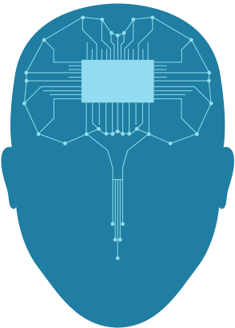
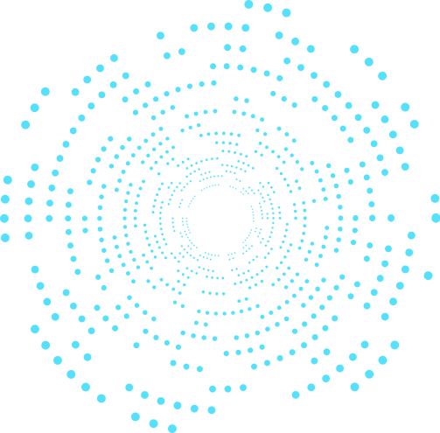



NUTRITION TRACKER
pitch deck by :
<affan />
<matt />
<prashan />

Slide 2
AGENDA
01
Quick Intro & Goals
02
Functions
03
Demo of the project
04
Possible Improvements
05
References

Slide 3
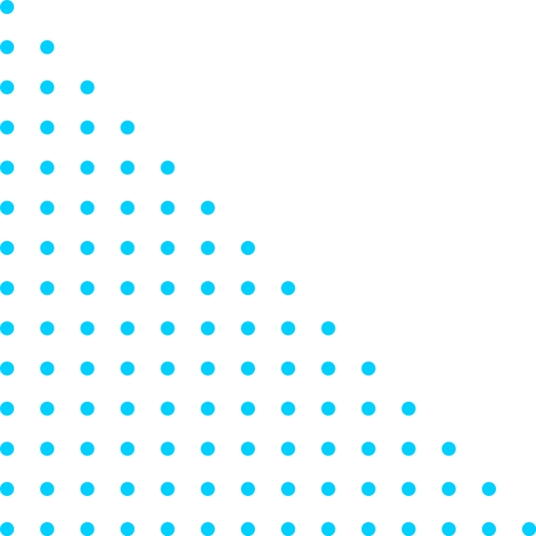

INTRO & GOAL
Our task was to design, implement and evaluate an intelligent agent that performed a simple task. The application we designed accepts user input in the form of barcodes and tracks how much specific nutrients the user has consumed. It then makes suggestions on foods the user can eat based on their previous eating habits, so they can make up for any nutrients the user has not consumed that the FDA recommends. We also provided a list of improvements we could implement to increase the general cosmetic appeal and increase algorithm complexity for better recommendations.

Slide 4

MENU()
ADD_FOOD()
The menu function is the main organizer or the controller of the program. It provides the user with several options and based on the user's choice, activates or calls the appropriate function. It is also responsible for validating whether the user wants to continue further or exit the program.
The primary purpose of add_food() function is self-explanatory. The function will keep track of and store different foods or nutrients that the user has consumed throughout the day.
ASSESS_DAY()
FUNCTIONS
CHECK_PAST_FOOD()
This function can be used to provide an overall analysis of different nutrients consumed by the user. It is able to compare the FDA's daily recommended amount for nutrients like vitamin-d, iron, calcium and potassium with the user's consumption and provide feedback.
This function is the first function that gets executed. The main objective of this function is to make decisions on whether a previously considered frequent food still holds true. The file "past_food.csv" contains the information of all the previously added foods.
HIGH_CHECK()
This function checks whether the food item sent to it is considered high in any of the four tracked nutrients. The function sets a value based on a rational variable that it compares to the nutrient amount in the food.

Slide 5


DEMO OF PROJECT

Slide 6
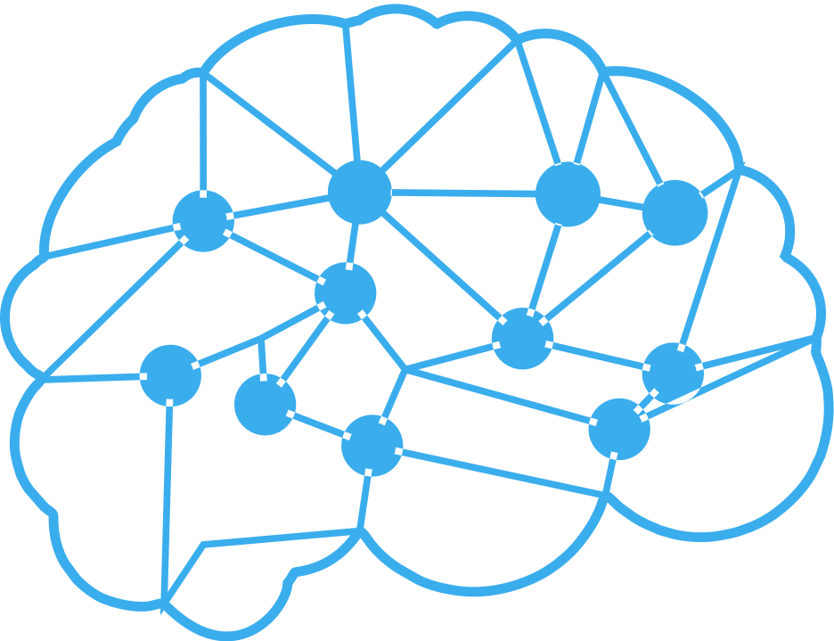

FUTURE
IMPROVEMENTS
This application has several things that could be improved, on both an AI and quality of life level. From having a better user interface to a more complicated AI implementation, here are the improvements we would make.
GUI (could use Tkinter)
More nutrients to track and the user could select a specific nutrient.
User points out their deficiency in a specific nutrient.
Using a database and User Accounts.
Using an app cross-platform .
Using collaborative filtering algorithm.

Slide 7
REFERENCES
Liu, Feng, and Wei-wei Guo. “A Multi-Organ Nucleus Segmentation Challenge - IEEE Xplore.” IEEExplore, 2019, https://ieeexplore.ieee.org/document/8880654.
Goldentouch, Lev. “How Many Repetitions for Long Term Retention?” Key To Study, 27 Dec. 2014, https://www.keytostudy.com/many-repetitions-long-term-retention/.
Jones, Taylor. “7 Healthy Foods That Are High in Vitamin D.” Healthline, Healthline Media, 5 May 2022, https://www.healthline.com/nutrition/9-foods-high-in-vitamin-d.
Spritzler, Franziska. “12 Healthy Foods That Are High in Iron.” Healthline, Healthline Media, 27 Jan. 2020, https://www.healthline.com/nutrition/healthy-iron-rich-foods.
Jennings, Kerri-Ann. “Top 15 Calcium-Rich Foods (Many Are Nondairy).” Healthline, Healthline Media, 4 Nov. 2021, https://www.healthline.com/nutrition/15-calcium-rich-foods.
Lang, Ariane. “Potassium Rich Foods: 18 Foods High in Potassium.” Healthline, Healthline Media, 4 Feb. 2022, https://www.healthline.com/nutrition/foods-loaded-with-potassium.

Slide 8
Thanks!
Do you have questions?

